Slide 1

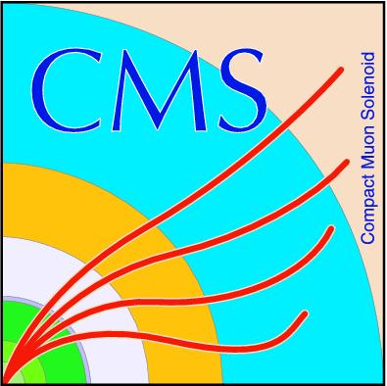

CERN Particle Collider Update for more discovery in high energy physics (HL LHC)
BTL research and assembly
Kristi Sevier, Dr. Maria Spiropulu, Dr. Adi Bornheim, Guillermos Reales Gutiérrez, Ianos Schmidt

Slide 2

Introduction
My name is Kristi Sevier
Major in mechanical engineering, focus in robotics, minor in aerospace
Strong interest in high energy physics
Third year at Caltech
Research Project Engineer Intern at CERN
Mentors: Dr. Maria Spiropulu and Dr. Adi Bornheim

Slide 3
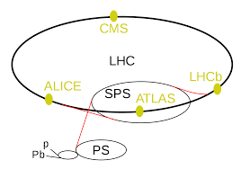
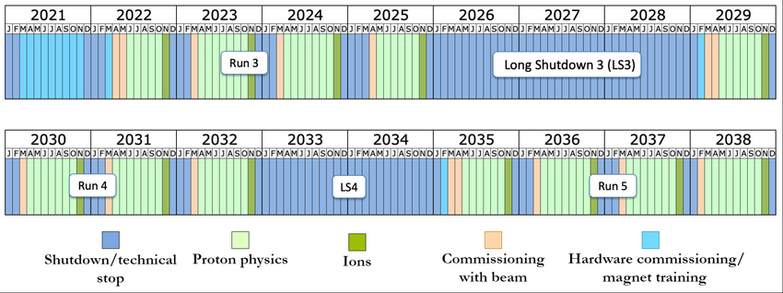
Background and Motivation
The Large Hadron Collider is the world's largest particle accelerator
2 high energy beams travel 27 km near light speed before colliding
Proton collisions occur in 1 of 4 detectors in the LHC and the detectors collect data so we can learn more about subatomic physics
Diagram from Wikipedia
ResearchGate paper on CMS HL LHC

Slide 4
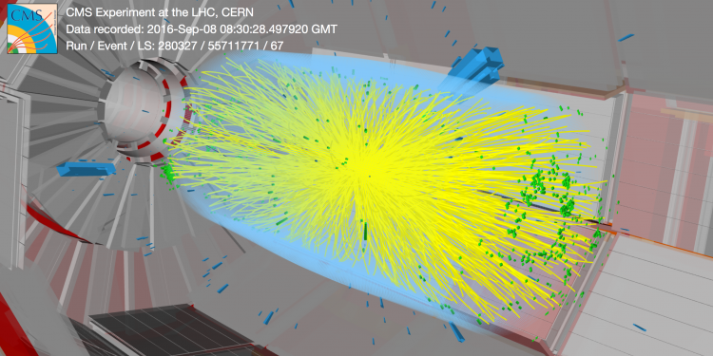
Background and Motivation
More collisions = more discovery of rare physics
LHC detectors process data from over a million collisions per min in phase 1 (current phase)
LHC detectors need to handle 15x more collisions for the HL LHC update (phase 2)
The High Luminosity Update reworks detectors to accomplish this
https://cms.cern/

Slide 5
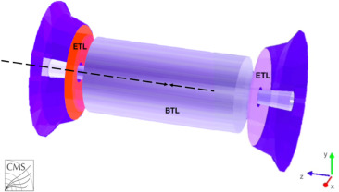
Background and Motivation
One detector is the CMS (compact muon solenoid)
MIP Timing Detector (MTD) added as a new layer in CMS
The MTD allows for higher resolution of particle collisions, so physicists can observe HEP phenomena
Important for observing cool physics and confirming what we know already in high energy physics/standard model
The MTD is made up of the Barrel Timing Layer (BTL), and the End Cap Timing Layer (ETL)
https://cms.cern

Slide 6
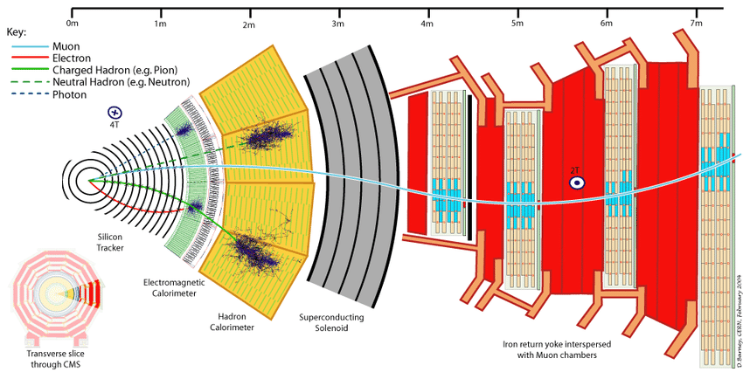
CMS Diagram (peeling the onion)
Researchgate CMS Diagram

Slide 7
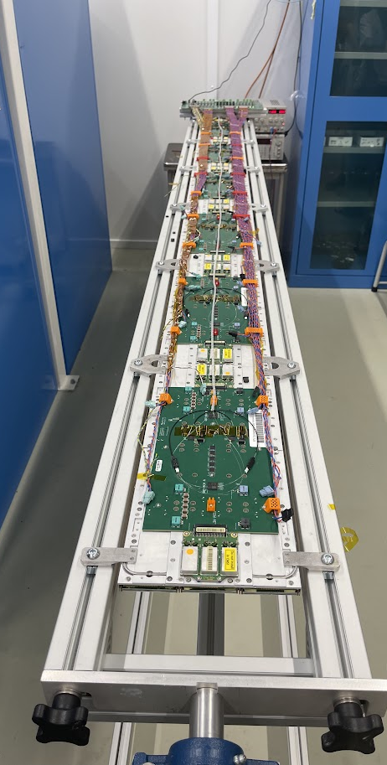
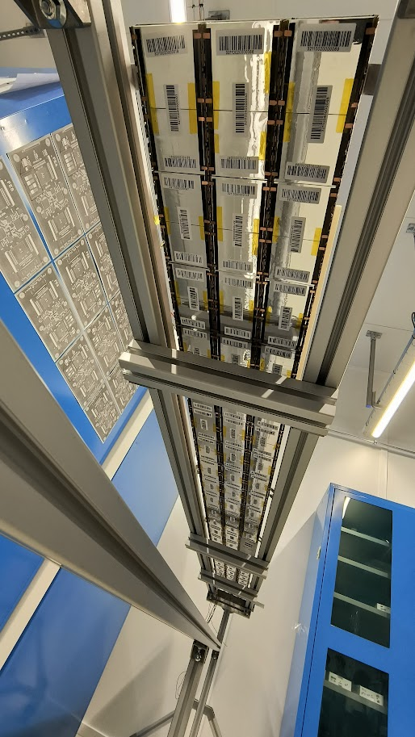
Summer Internship Overview
Assembly and testing of the BTL
Barrel Timing Layer is made from 72 6 ft long trays of detector modules
The objective is to successfully assemble and test trays so it is ready for installation in CMS.
Sensor and detector modules, cold plate trays, and completed trays need to be assembled and tested to ensure proper function

Slide 8
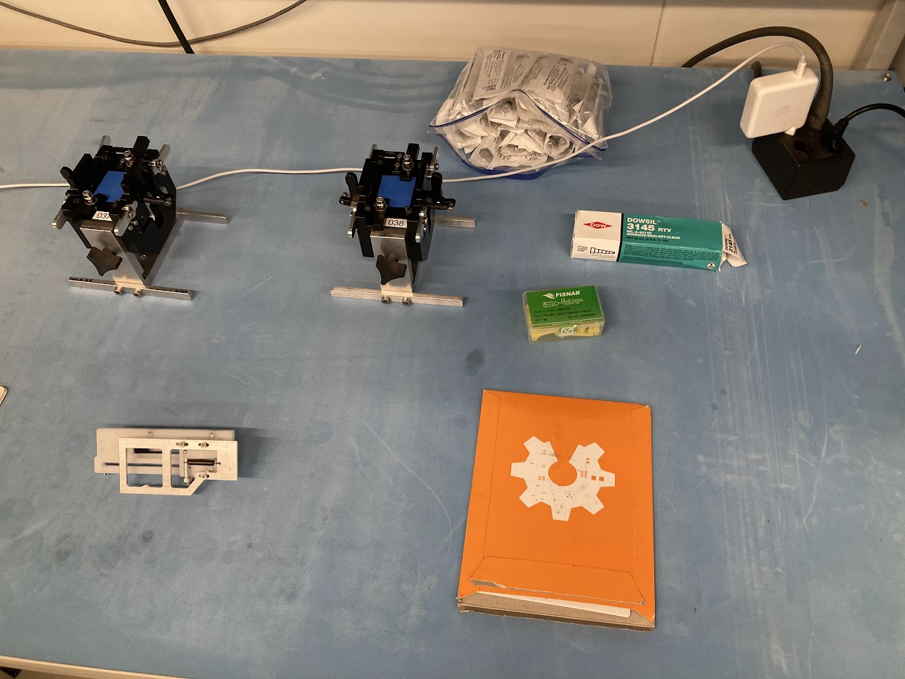
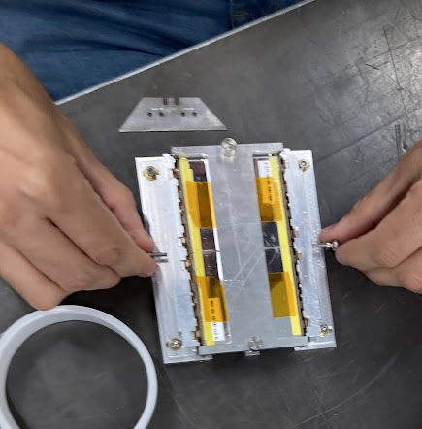
Summer Internship Overview
Summary of Methods for BTL Assembly/Testing:
Making tools for precise assembly of sensor modules and detector modules
Using an assembly line of people to make the sensor and detector modules
Testing the light yield of sensor modules using a dark box
Testing cooling capabilities of individual detector modules using arduino
Testing cold plate trays thermal properties and ability to cool with CO2 pipes
Testing cooling capabilities of fully assembled trays
Goal: refine assembly & testing process for most efficiency & accuracy

Slide 9
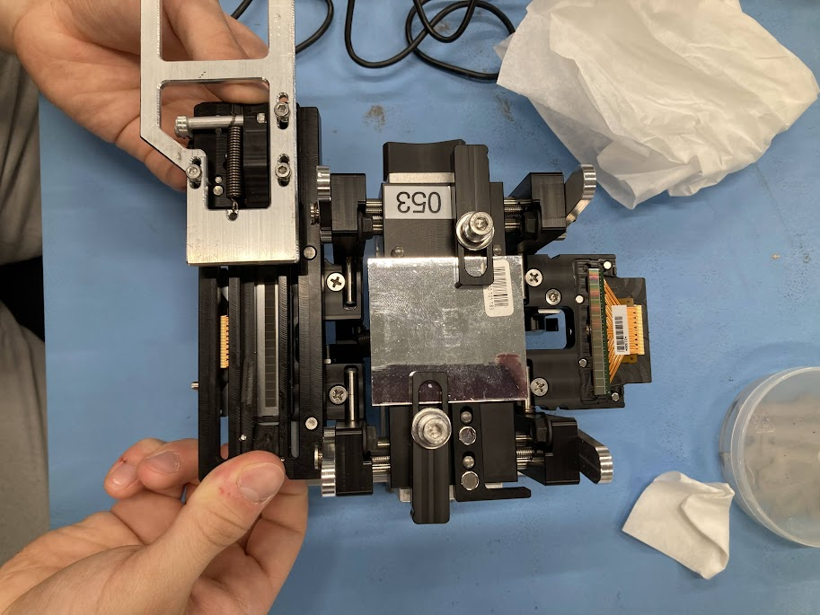
Methodology
Sensor Modules:
Sensor modules are 2 Silicon Photomultipliers (SiPMs) and 1 LYSO crystal (Cerium doped Lutetium) which help detector modules detect photons.
Gluing the SiPMs on LYSO require precision, as glue layers affect light yield
A sensor module assembly jig can properly glue SiPMs on LYSO
A gluing jig spreads an even layer of glue onto each SiPM
Dry sensor modules are tested
Placed into dark box connected to readout units to read light yield
Python program interprets light yield and provides plots
Look for consistent, high light yield

Slide 10
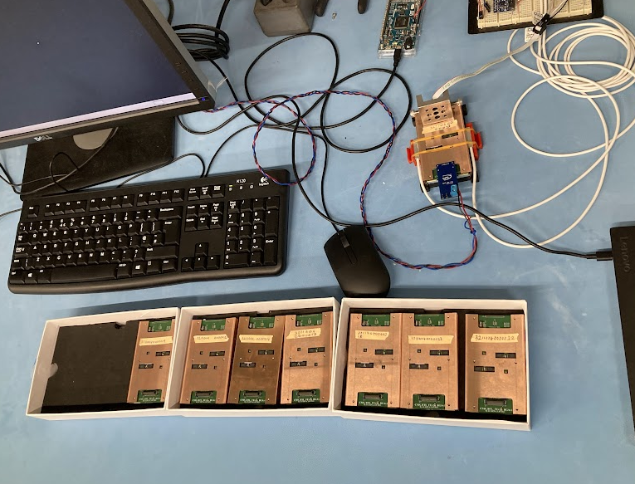
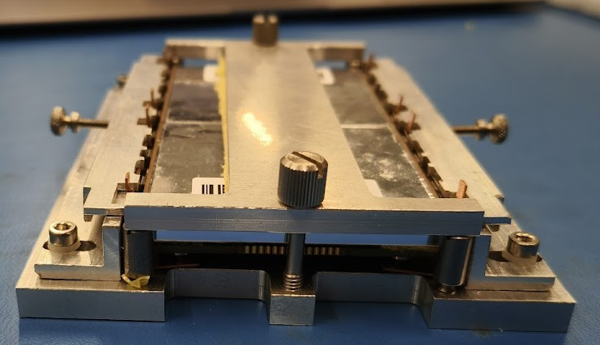
Methodology
Detector Modules:
Detector modules are front end boards with 2 sensor modules
Placed in a copper housing using a tool
Precise application of copper housing for optimal electrical readout.
Hence the use of tool to upper right
The TECs (temperature electronic components) on each detector module cool them to make less work for cold plate
Arduino testing set-up for measuring cooling of TECS is on right
The arduino runs for 5 minutes while the detector module cools, and the plots show max temp difference

Slide 11
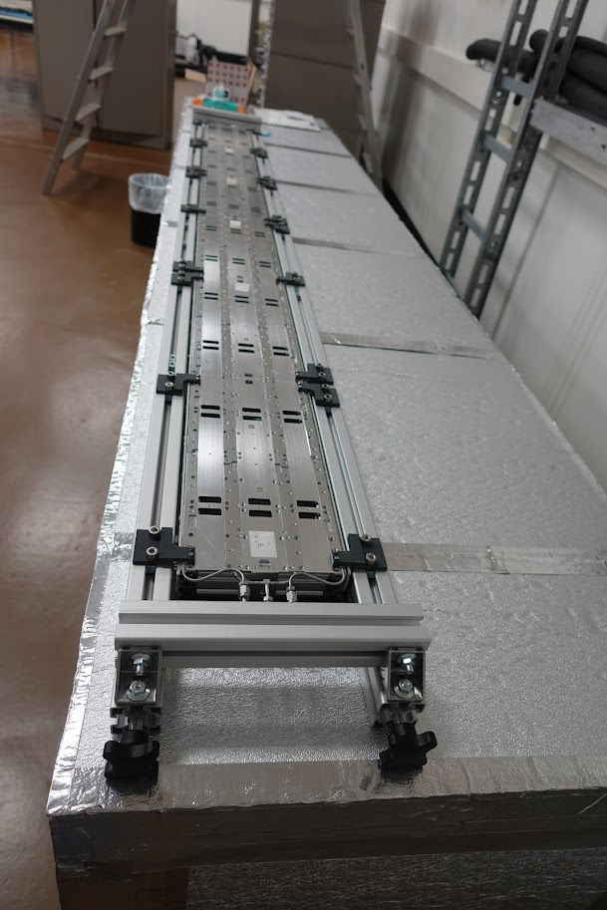
Methodology
Cold Plates:
Cold plates Assembly
6 sections of cold plate using pins,
thermal paste in cold tube groves of plate
placing the CO2 tubes within the groves
Installing metal attachments over the cold tubes
Cooling test: can tray cool to -30 degrees Celsius from freezing?
Place in a cold box (insulated box pumped with dry cold air)
Run Co2 through cold tubes and measure change in temp

Slide 12
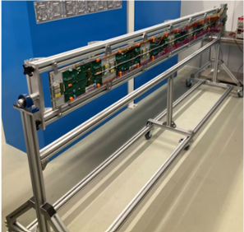
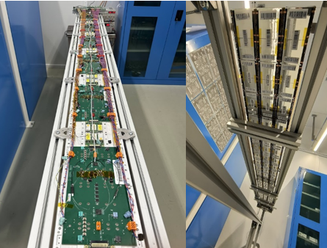
Methodology
Assembled Trays:
Assembly test stand used to install readout units and detector modules onto trays
The thermal cooling properties of the detector modules TECs tested individually and then with cold plate TEC activation

Slide 13
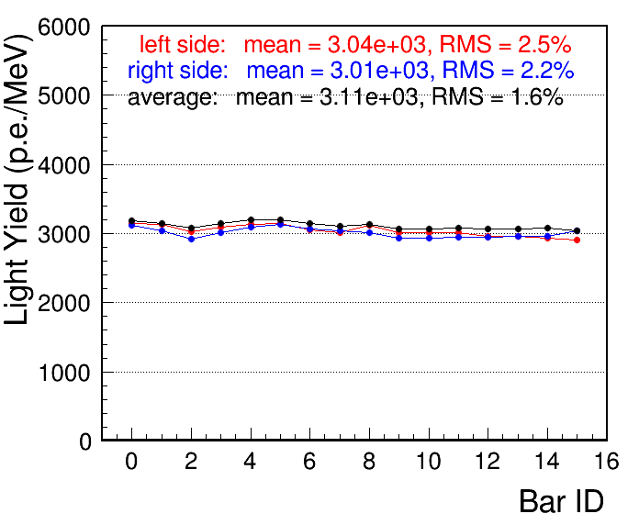
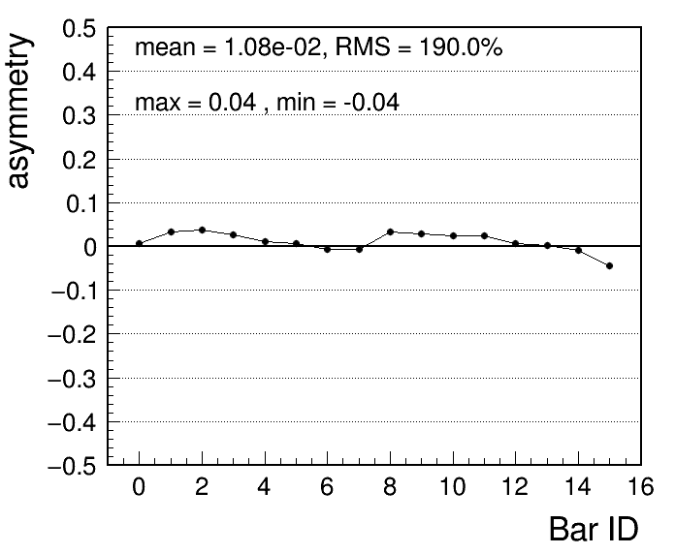
Results and Discussion/Conclusion
Example of sensor module light yield readings:

Slide 14
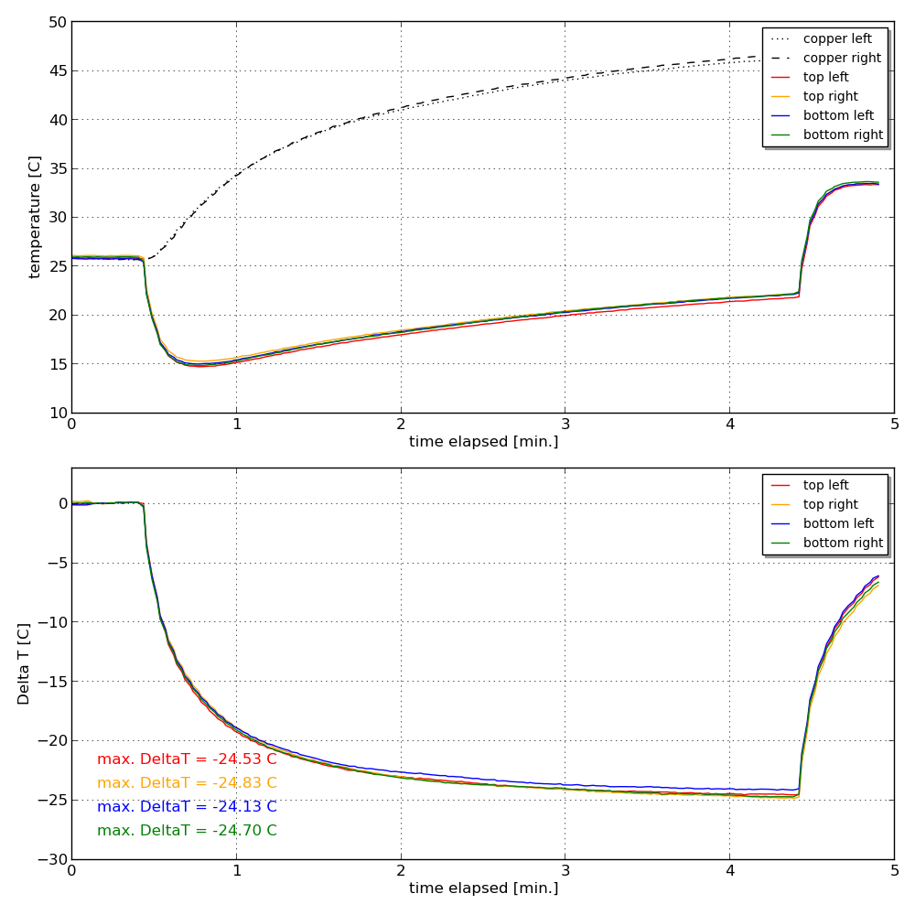
Results and Discussion/Conclusion
Example of a common detector modules TEC reading to right:
Top: detector module temp compared to its copper housing temp
Bottom: how much each TEC cooled in detector module

Slide 15
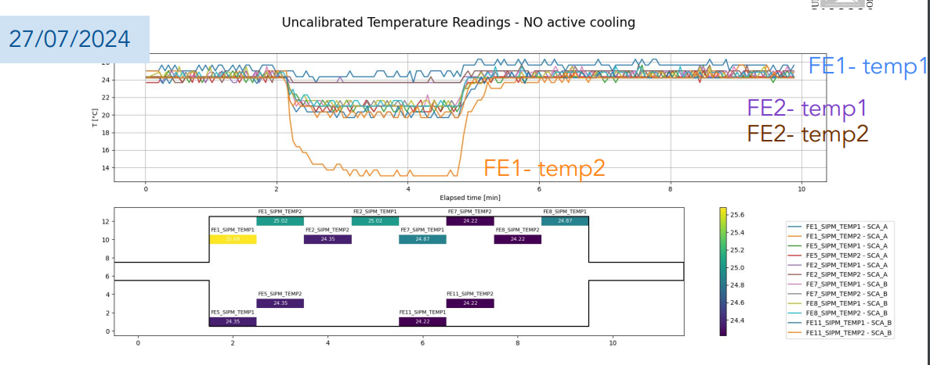
Results and Discussion/Conclusion
Example of thermal results of the first fully assembled BTL Tray at CERN:

Slide 16
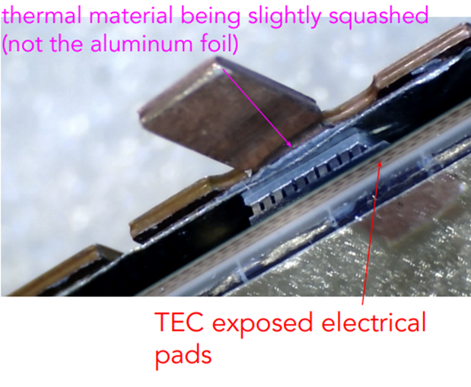
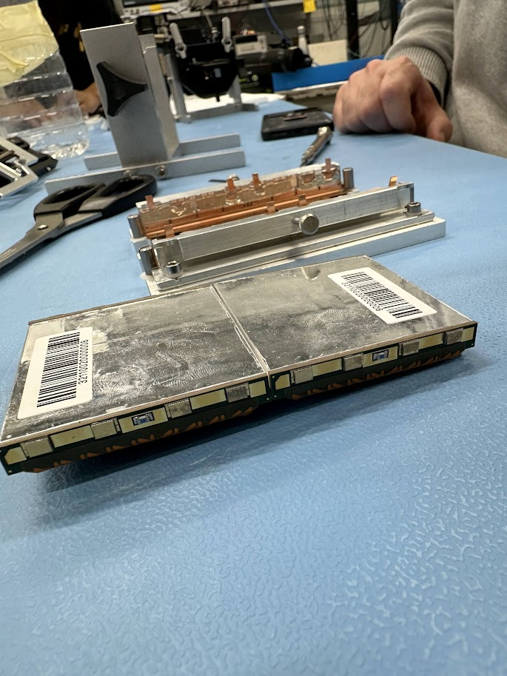
Results and Discussion/Conclusion
Full Tray Thermal Results and Interpretation:
Some detector modules had electrical short
Made others cool rapidly while shorted one did not change temp.
This is due to current flow
After iterative testing, we found the thermal material lining copper housing was too tight on TECS, causing the short
More specifically, it was the aluminum on the thermal material against the TECS that caused an issue

Slide 17
Conclusion
Currently the lab is testing other thermal materials for the inside of the copper housing
Running thermal tests for detector modules with different thermal material
Need to either adjust the thermal material in copper housing, how tightly we tighten the copper housing using the DM housing tool, or both
Once we can get tray working, we will have a more optimized process of assembling and testing BTL trays for assembly

Slide 18
Acknowledgements
I would like to thank:
My mentors Adi Bornheim and Maria Spiropulu for this research opportunity
Guillermo Reales Gutierrez and Ianos Schmidt for their collaboration and support in mechanical engineering projects
Everyone at CERN working on the BTL Assembly project for answering questions/ helping me learn more about this research
Department of Engineering U.S. CMS MTD/CPT grant for funding this research
SFP program at Caltech

Slide 19

Thank you!
Questions?

